Slide 1

6.4.1 Matrices

Slide 2
Introduction
In this topic, we will
  Define matrices and its dimensions
  Describe the rows and columns of a matrix and the column vectors
  Explain how to identify specific entries
  Define the diagonal, super-diagonal and sub-diagonal entries

Slide 3
Matrix representation
We have now seen that these two problems are equivalent:
  Given this system of linear equations
  we can write it as

Slide 4
Matrix representation
We will now define a matrix A that amalgamates the coefficients,
so given
define the matrix

Slide 5
Matrix representation
For example,

Slide 6
Dimensions
The dimensions of a matrix corresponding to
a system of m linear equations in n unknowns is said to be m × n
  A matrix is said to have m rows
  and n columns
m
n

Slide 7
Indexing
Individual entries of a matrix may be identified by a pair of indices
  a_{i,j} represents the entry in Row i and Column j in the matrix A
Row 2
Column 3

Slide 8
Indexing
Here is a 7 × 6 matrix
c_{3,2} = 8.2
c_{1,4} = –9.1
c_{3,2} = – 8.3
c_{6,6} = 9.2
c_{4,4} = 7.6

Slide 9

Indexing
c_{i,j}
My aide memoire: The location of
“Down the stairs, and into the crypt.”
Eric Pouhier

Slide 10
Column vectors of a matrix
Because a system of linear equations is equivalent to finding a linear combination of vectors equaling a target vector,
we will identify the columns as vectors
  The columns of matrices A, B and C are a_{j}, b_{j} and c_{j}, respectively
  The entries of these matrices are a_{i,j}, b_{i,j} and c_{i,j}, respectively

Slide 11
Column vectors of a matrix
For example, given the matrix
the column vectors are

Slide 12
Square matrices
When m = n, for obvious reasons, we call a matrix a square matrix

Slide 13
Diagonal entries
The diagonal entries of a matrix are those which indices are equal
  We often will refer to diagonal entries c_{i,i}
c_{1,1} = 3.2
c_{2,2} = –4.5
c_{3,3} = 6.0
c_{4,4} = 7.6
c_{5,5} = –7.8
c_{6,6} = 9.2

Slide 14
Off-diagonal entries
All entries not on the diagonal are called off-diagonal entries

Slide 15
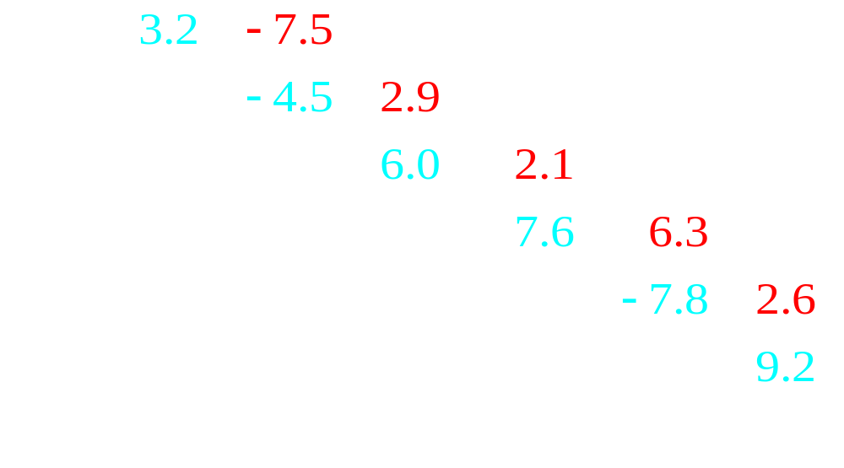
Super-diagonal entries
All entries immediately to the right and above the diagonal are said to be on the super-diagonal

Slide 16
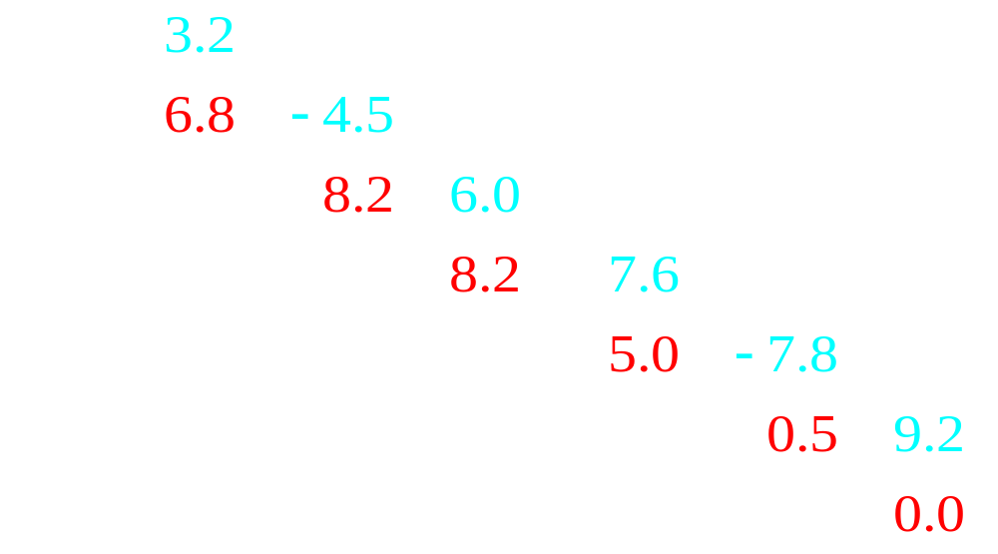
Sub-diagonal entries
All entries immediately to the left or below the diagonal are said to be on the sub-diagonal

Slide 17
Square matrices
In a square matrix, it is easier to identify the
  Diagonal entries
  Super-diagonal entries
  Sub-diagonal entries

Slide 18
Zero matrix
Like the zero vector, the m × n matrix of all zeros is described as the m × n zero matrix
  It is denoted with an italicized O subscripted with m, n

Slide 19
Summary
Following this topic, you now
  Understand the definition of a matrix
  Know the dimensions are the number of rows by the number of columns
    If these are equal, it is a square matrix
  Know where the entry a_{5,7} is in a matrix
  Know which are the diagonal, super-diagonal and sub-diagonal entries of a matrix
  Understand the ideal of the zero matrix O_{m,n}

Slide 20
References
[1] https://en.wikipedia.org/wiki/Matrix_(mathematics)

Slide 21
Acknowledgments
Jaeden “The Combination” Smith for noting the duplicated narration on Slide 12

Slide 22



Colophon
These slides were prepared using the Cambria typeface. Mathematical equations use Times New Roman, and source code is presented using Consolas. Mathematical equations are prepared in MathType by Design Science, Inc.
Examples may be formulated and checked using Maple by Maplesoft, Inc.
The photographs of flowers and a monarch butter appearing on the title slide and accenting the top of each other slide were taken at the Royal Botanical Gardens in October of 2017 by Douglas Wilhelm Harder. Please see
https://www.rbg.ca/
for more information.

Slide 23
Disclaimer
These slides are provided for the ne 112 Linear algebra for nanotechnology engineering course taught at the University of Waterloo. The material in it reflects the authors’ best judgment in light of the information available to them at the time of preparation. Any reliance on these course slides by any party for any other purpose are the responsibility of such parties. The authors accept no responsibility for damages, if any, suffered by any party as a result of decisions made or actions based on these course slides for any other purpose than that for which it was intended.

